Slide 1
Floyd Warshall Algorithm-
Floyd Warshall Algorithm is a famous algorithm.
It is used to solve All Pairs Shortest Path Problem.
It computes the shortest path between every pair of vertices of the given graph.
Floyd Warshall Algorithm is an example of dynamic programming approach.

Slide 2
Advantages-
Floyd Warshall Algorithm has the following main advantages-
It is extremely simple.
It is easy to implement.

Slide 4
Algorithm-
Floyd Warshall Algorithm is as shown below-
Create a |V| x |V| matrix // It represents the distance between every pair of vertices as given
For each cell (i,j) in M do-
if i = = j
M[ i ][ j ] = 0 // For all diagonal elements, value = 0
if (i , j) is an edge in E
M[ i ][ j ] = weight(i,j) // If there exists a direct edge between the vertices, value = weight of edge
else
M[ i ][ j ] = infinity // If there is no direct edge between the vertices, value = ∞
for k from 1 to |V|
for i from 1 to |V|
for j from 1 to |V|
if M[ i ][ j ] > M[ i ][ k ] + M[ k ][ j ]
M[ i ][ j ] = M[ i ][ k ] + M[ k ][ j ]

Slide 5
Time Complexity-
Floyd Warshall Algorithm consists of three loops over all the nodes.
The inner most loop consists of only constant complexity operations.
Hence, the asymptotic complexity of Floyd Warshall algorithm is O(n³).
Here, n is the number of nodes in the given graph.

Slide 6
When Floyd Warshall Algorithm Is Used?
Floyd Warshall Algorithm is best suited for dense graphs.
This is because its complexity depends only on the number of vertices in the given graph.
For sparse graphs, Johnson’s Algorithm is more suitable.

Slide 7
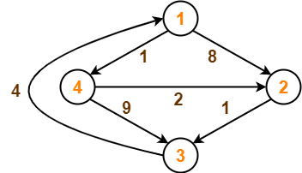
Problem-
Consider the following directed weighted graph-

Slide 8
Using Floyd Warshall Algorithm, find the shortest path distance between every pair of vertices.
Solution-
Step-01:
Remove all the self loops and parallel edges (keeping the lowest weight edge) from the graph.
In the given graph, there are neither self edges nor parallel edges.

Slide 9
tep-02:
Write the initial distance matrix.
It represents the distance between every pair of vertices in the form of given weights.
For diagonal elements (representing self-loops), distance value = 0.
For vertices having a direct edge between them, distance value = weight of that edge.
For vertices having no direct edge between them, distance value = ∞.

Slide 10
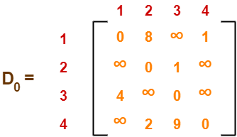
Initial distance matrix for the given graph is-

Slide 11
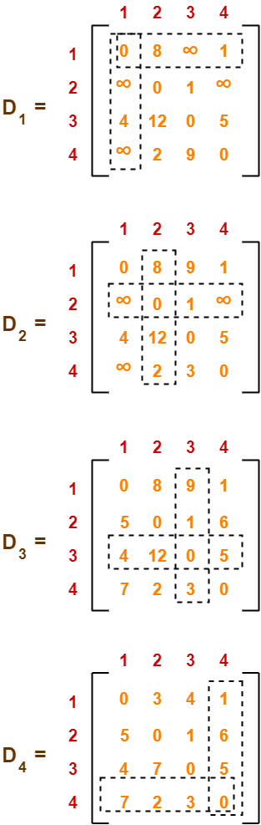
Step-03:
Using Floyd Warshall Algorithm, write the following 4 matrices-

Slide 12
Remember-
In the above problem, there are 4 vertices in the given graph.
So, there will be total 4 matrices of order 4 x 4 in the solution excluding the initial distance matrix.
Diagonal elements of each matrix will always be 0.

